Slide 1


י"ט סיון, תשע"ז
Yehuda Livnoni
Or Evron
Prof. Boaz Ben-Moshe

Slide 2
What is MobiLAB ?

Slide 3
GPS
Camera
SMS
Temperature
Battery level
Sound
Barometer Pressure
External sensors
Upload data to cloud (Http request )
Using the ultrahigh frequency (DragonLink) ability
Logger file

Slide 4
How it works ?

Slide 5

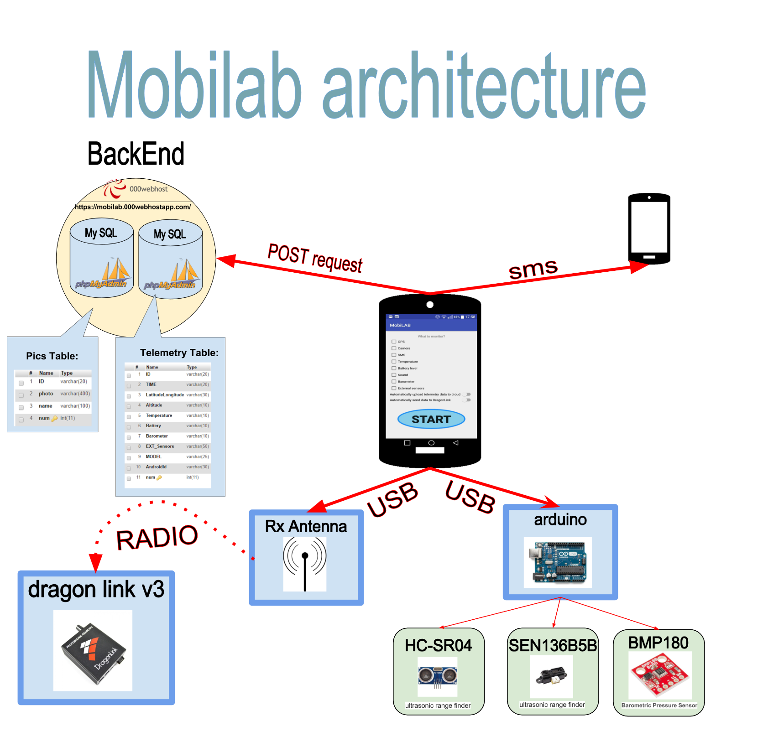
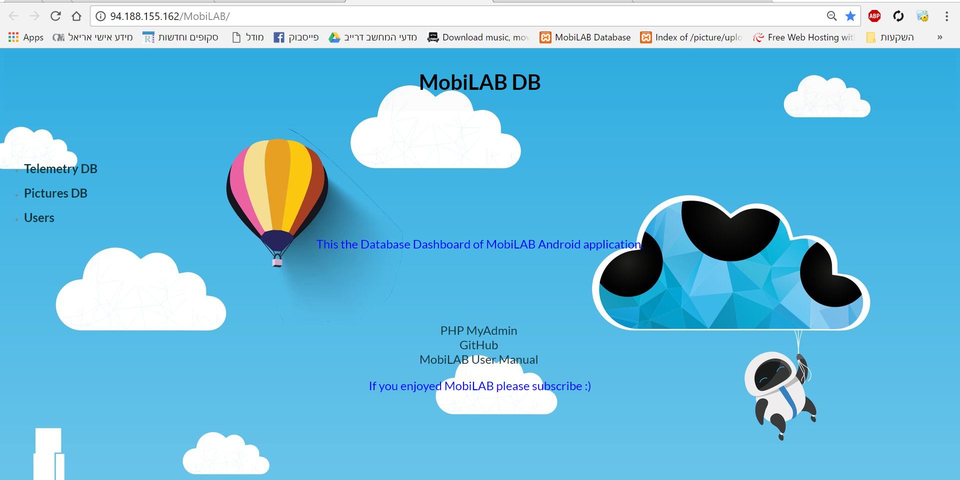

Slide 6
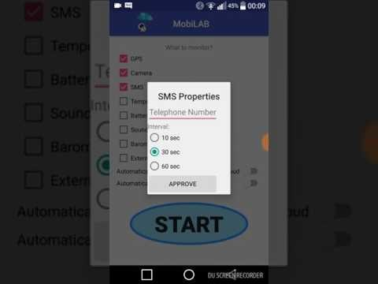
Video of how it works…
You tube link

Slide 7
Our web site

Slide 8
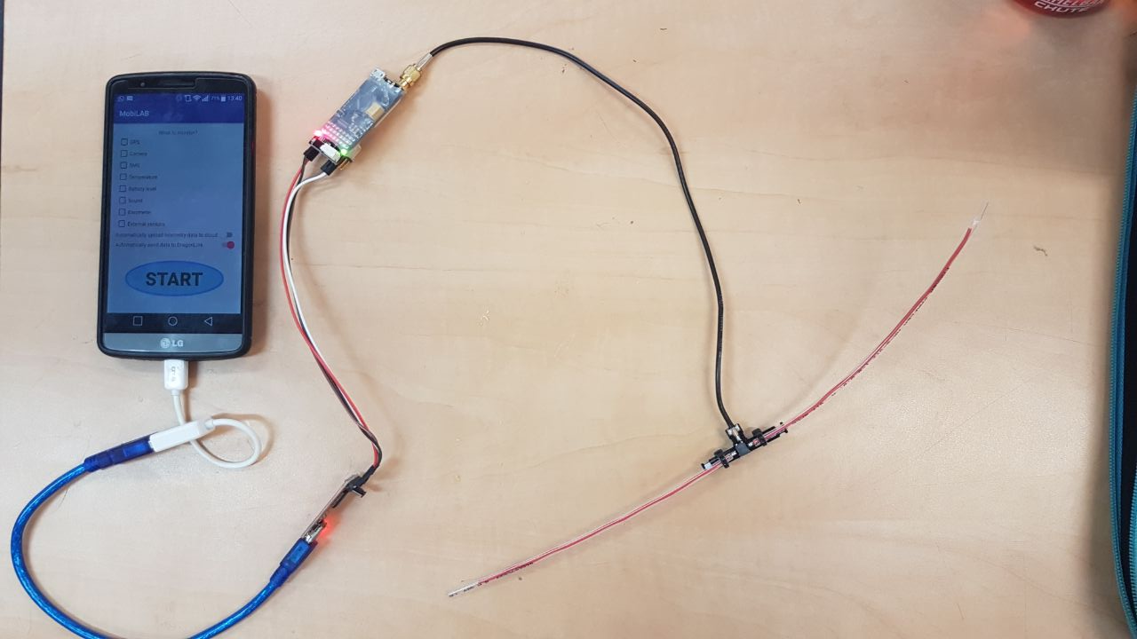
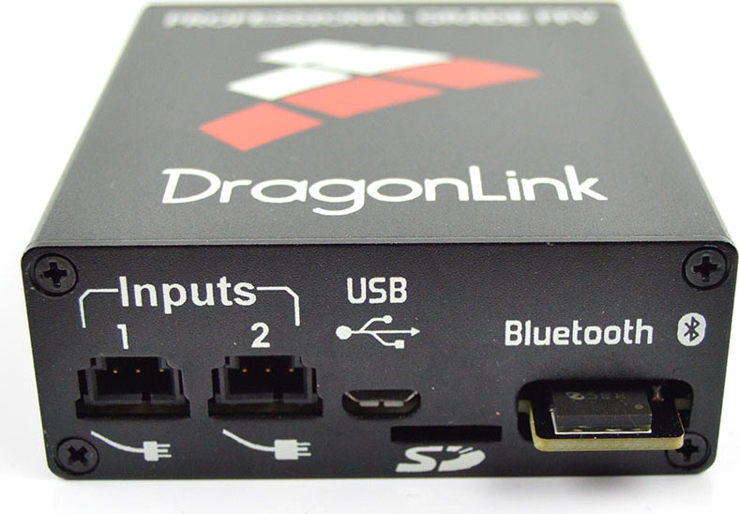
UHF communication (DragonLink):

Slide 9
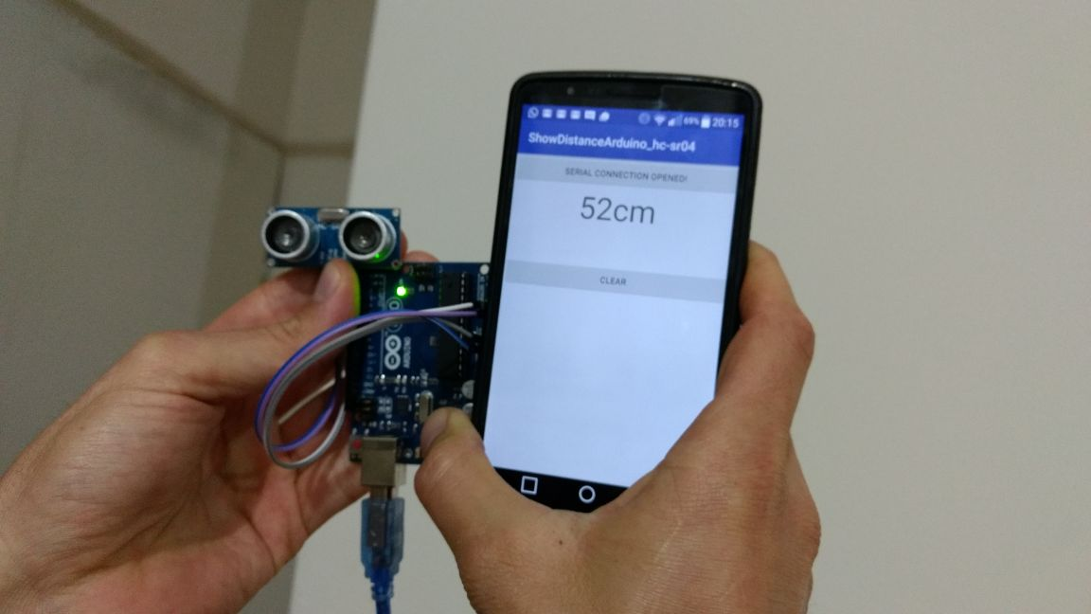
External sensors - Arduino

Slide 10
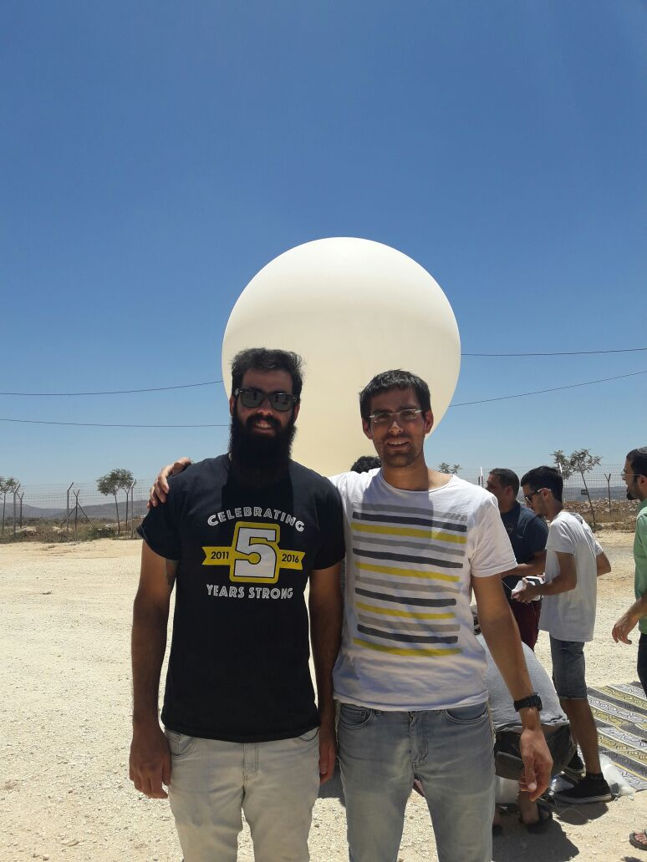
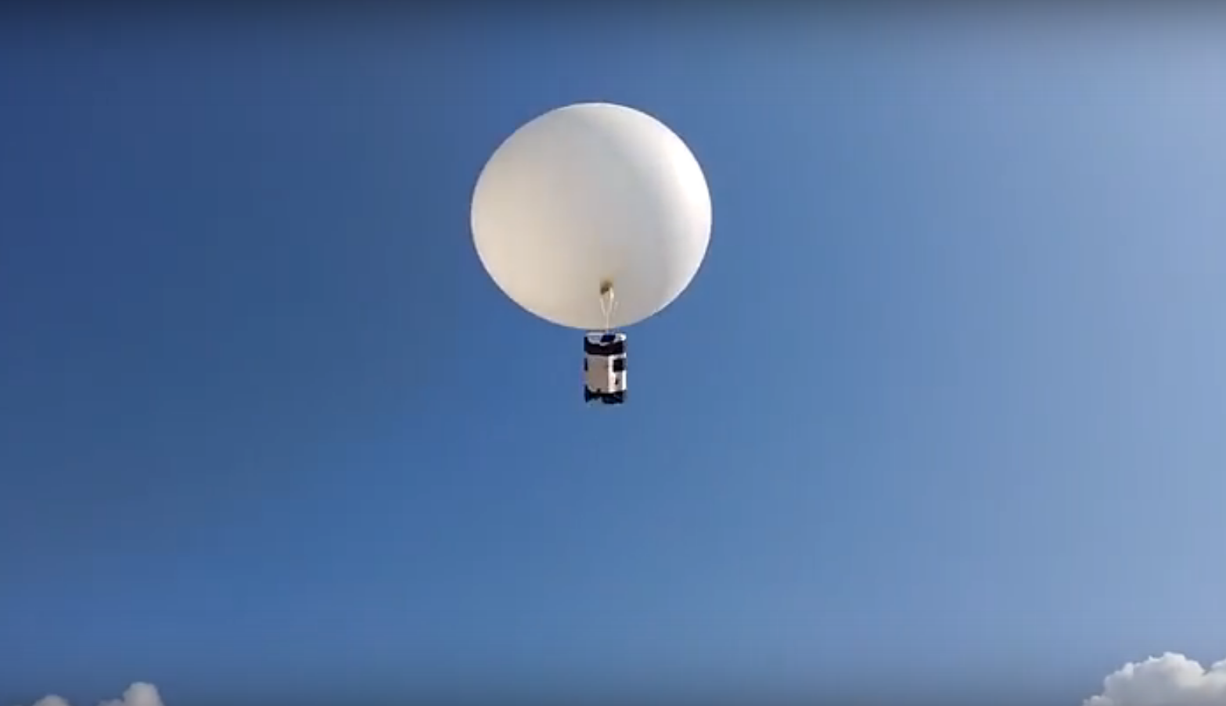
MobiLAB and meteorological balloon

Slide 11
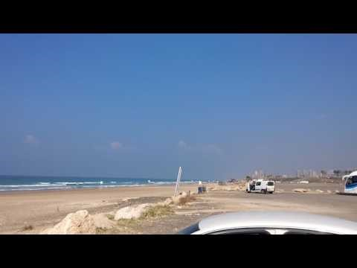
MobiLAB and meteorological balloon
You tube link

Slide 12
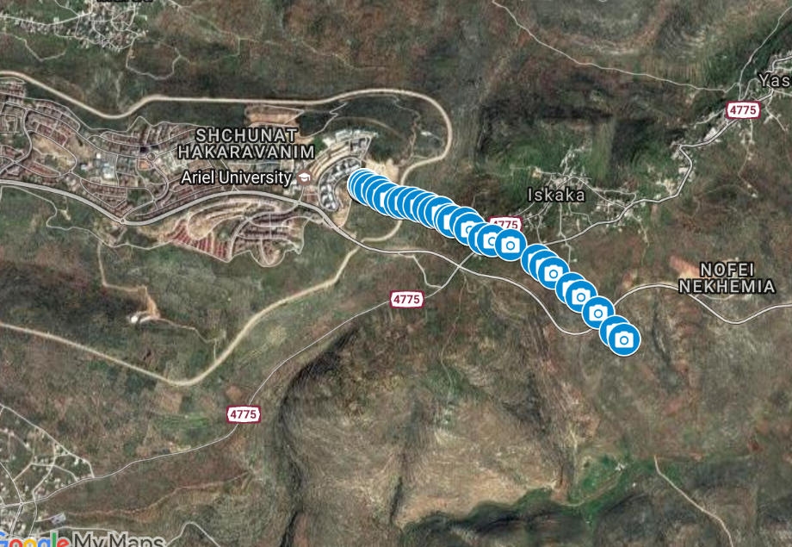
Ariel experiment - 13.6.17

Slide 13
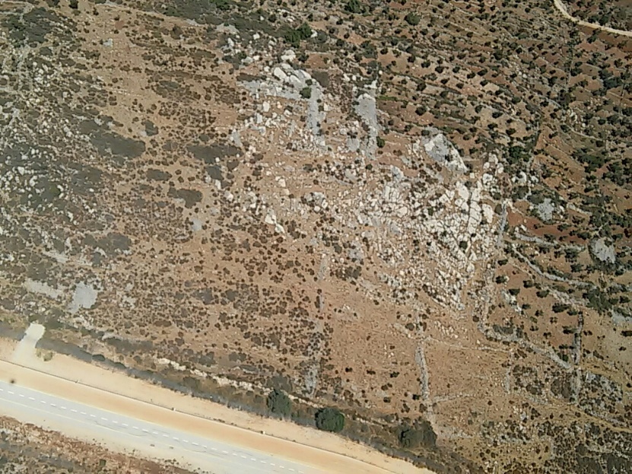
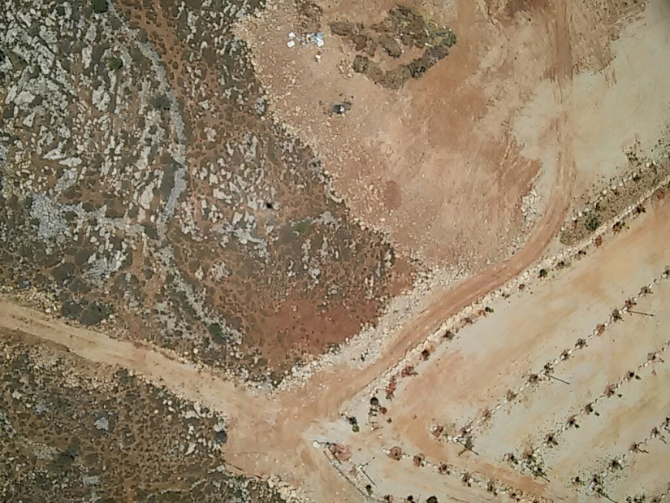
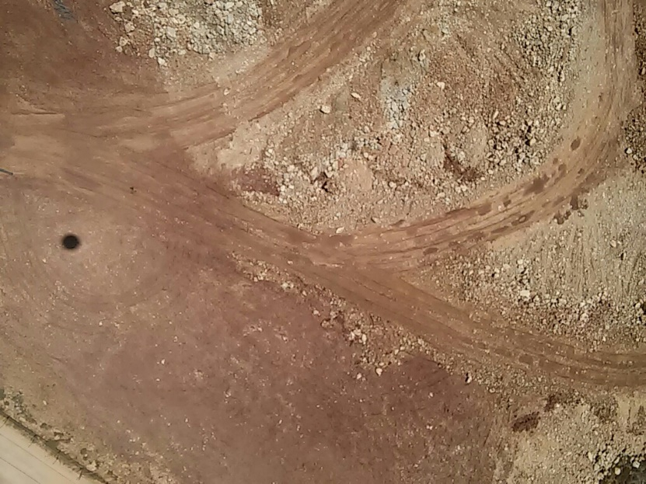

Ariel experiment - 13.6.17

Slide 14
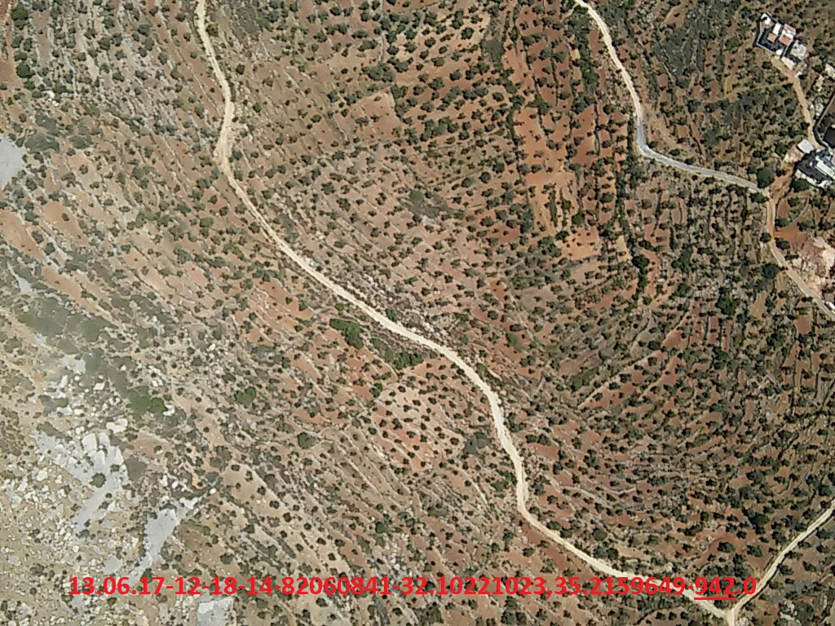
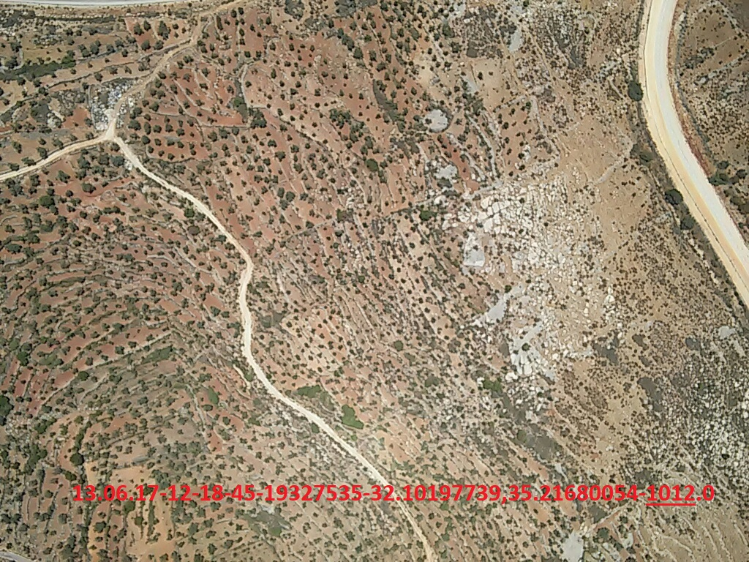
Ariel experiment - 13.6.17

Slide 15
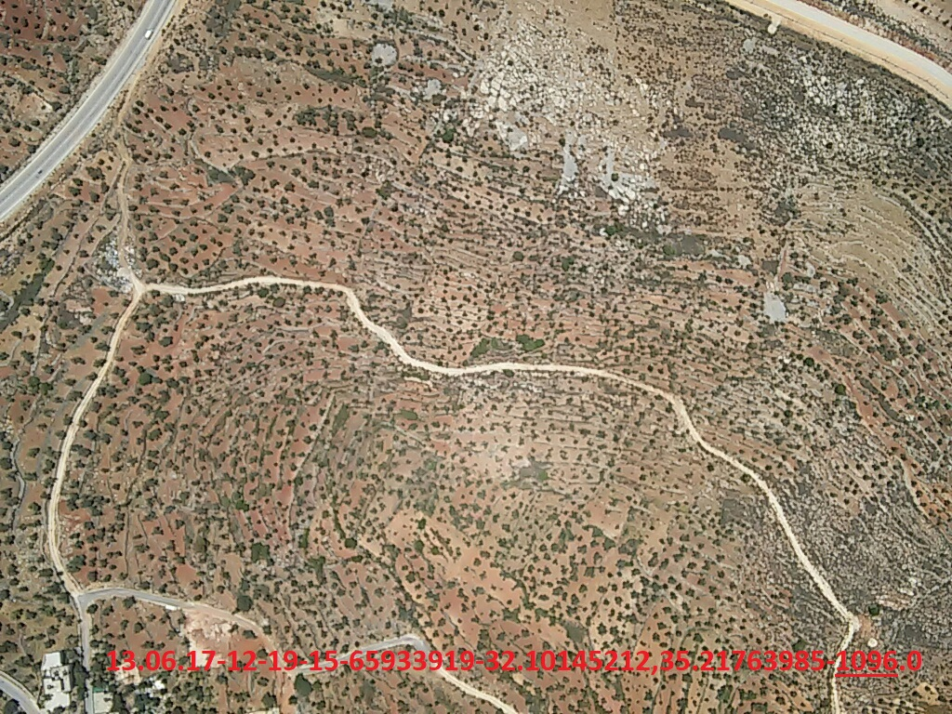
Ariel experiment - 13.6.17

Slide 16
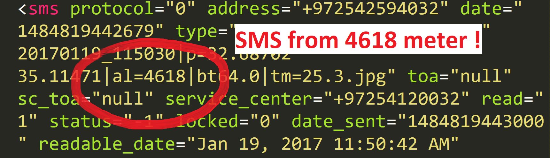
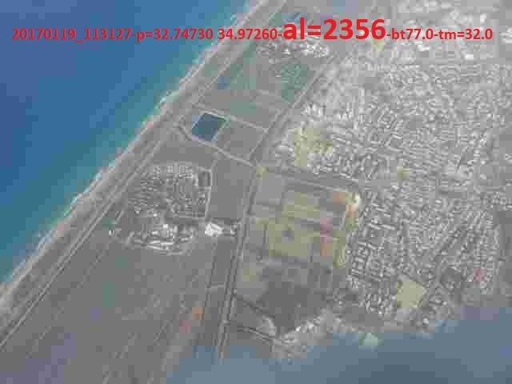
Experiment in Haifa

Slide 17
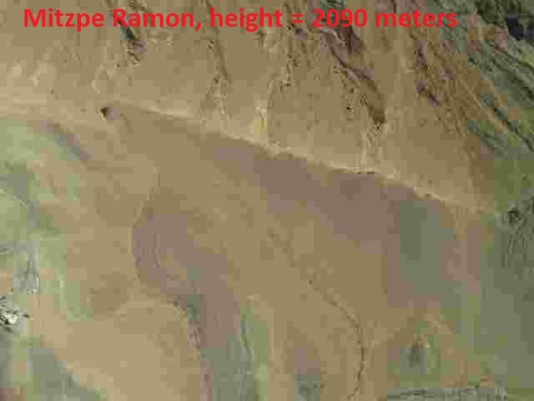
Experiment in Mizpe Ramon

Slide 18
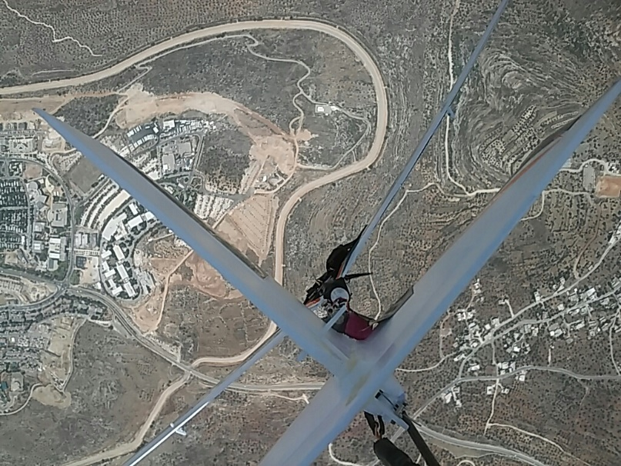
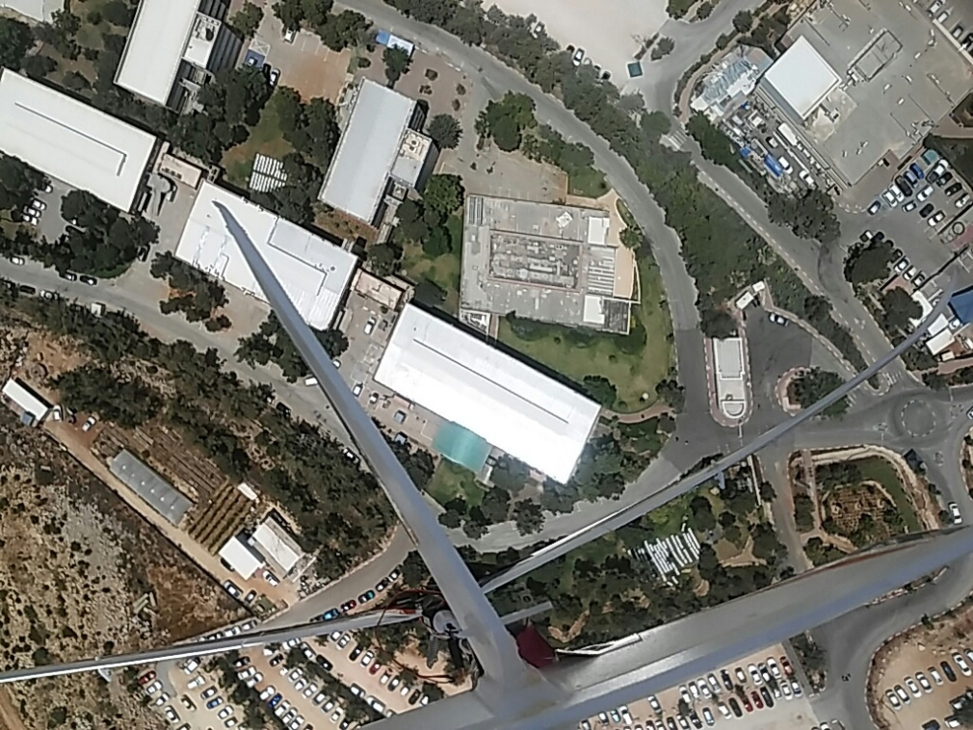
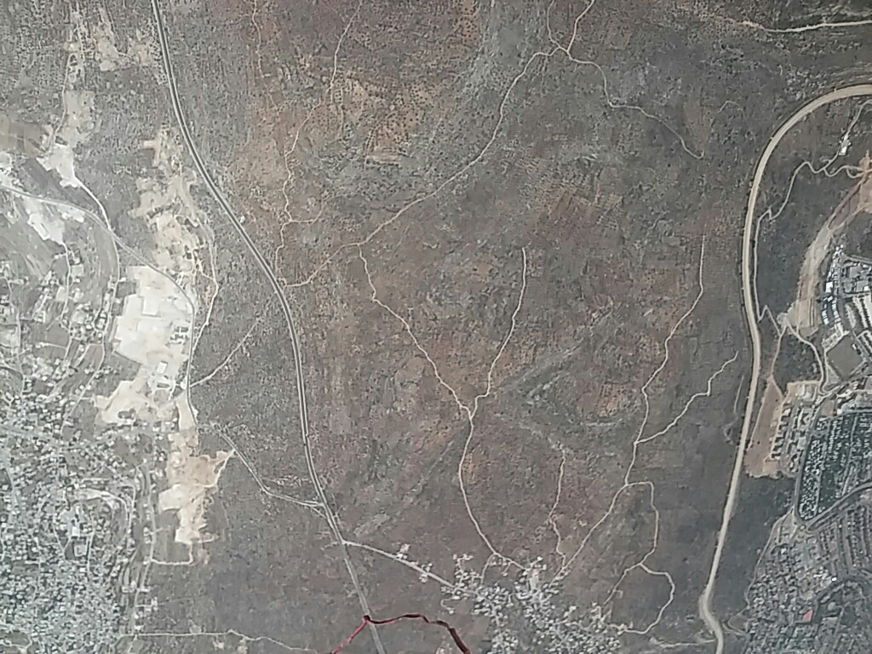
Experiment in Ariel
5.7.17

Slide 19
learning process
Object Oriented Programming.
Data Base (SQL).
Computer networking.
Version control system (github, 2 branch) – dev – prod.
Self learning scripting and web developing.
Using and integrating open source projects.
Data structures.
Operation Systems and Syncing Algorithms.

Slide 20
Future work
compressing pictures relative to signal power.
Application UI improvement.
Fully support with background runs (as a service).
Users Management dashboard.
Video capturing.

